Slide 1

Assignment 6.1
Clayton Oswald

Slide 2

Steps for assignment
Created Table in Oracle
Created Web Project with JSP and XML
Linked Web Project With Tomcat and Oracle
Ran Project Through Tomcat Server
Localhost 8088
Tested inputs
Screenshot Results

Slide 3
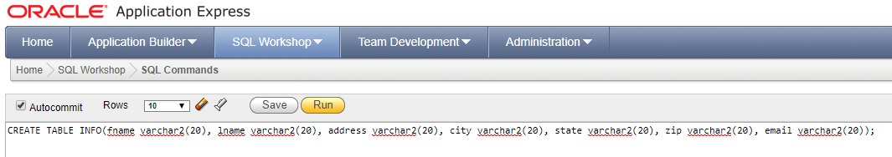
Sql table

Slide 4
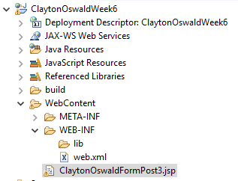
Jsp and XML File

Slide 5
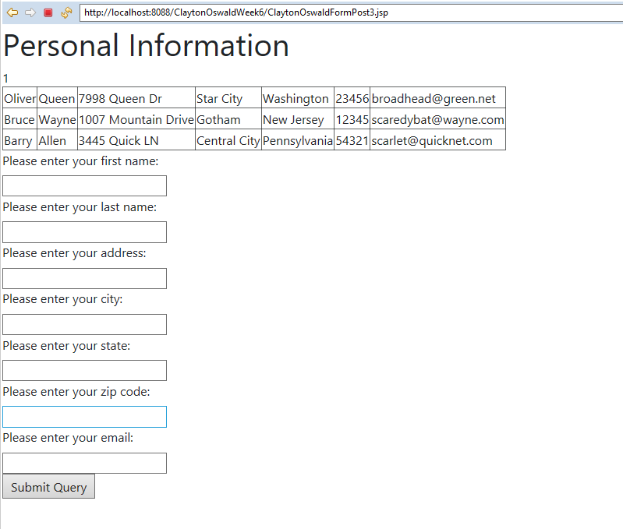

Testing Program and table

